Slide 1
KEPLER’S LAW OF PLANETARY MOTION
Presented by:
Mrs. Shalini
Assistant Professor of Mathematics

Slide 2
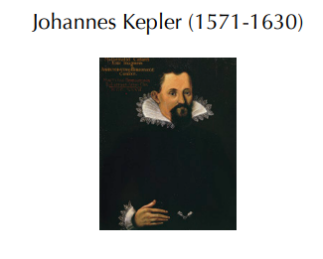

Slide 3
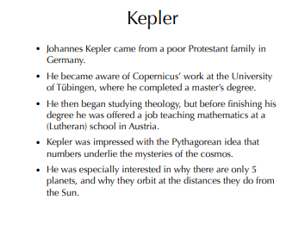

Slide 4
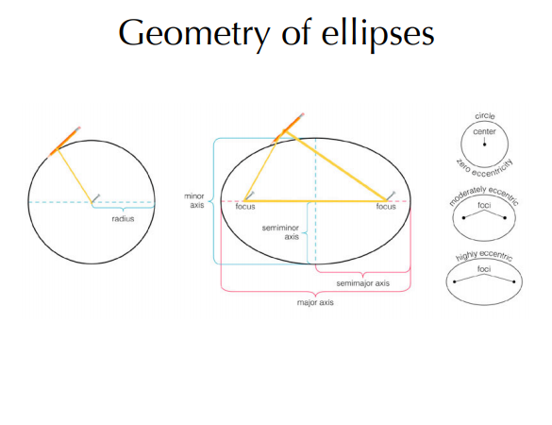

Slide 5
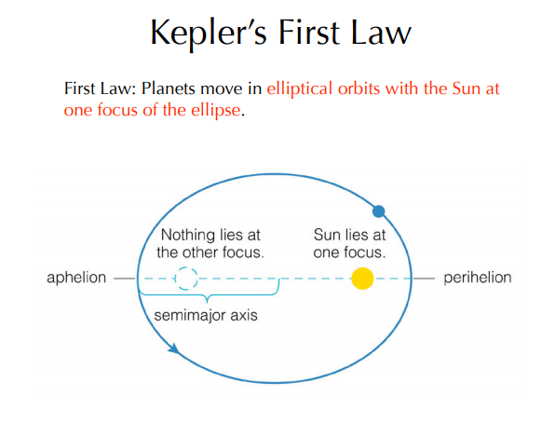

Slide 6
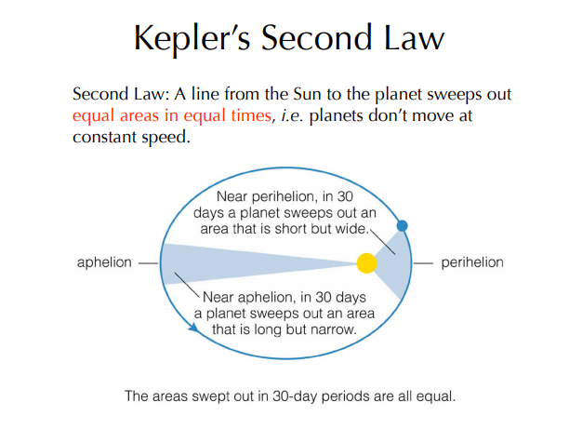

Slide 7
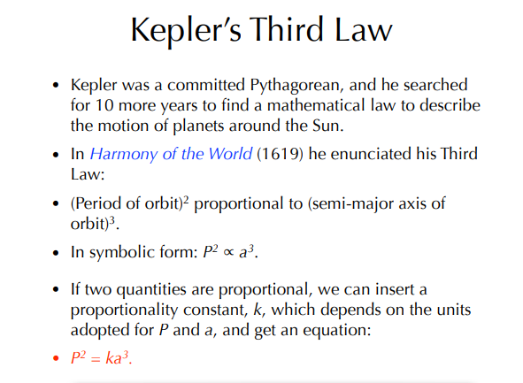

Slide 8
